Slide 1
Chapter 5:
Design Principles II: Flexibility, Reusability and Efficiency

Slide 2
Objectives
To introduce the following design principles
  Flexibility
  Reusability
  Efficiency

Slide 3
Flexibility
Flexible design implies a design that can easily accommodate the changes
Aspects of flexibility:
  Adding more of the same kind of functionality
    Example (banking application): handle more kinds of accounts without having to change the existing design or code
  Adding different functionality
    Example: add withdraw function to existing deposit functionality
  Changing functionality
    Example: allow overdrafts

Slide 4

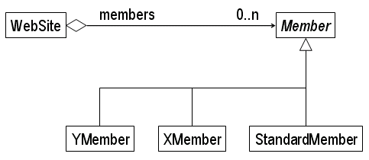
Flexibility: Designs for Adding More of the Same Kind of Functionality
Registering members at a web site
  Design 1:
  Design 2: a flexible design

Slide 5
Flexibility: Design for Adding Different Functionality
Alternative situations - within the scope of:
  A list of related functions
    Example: add print to an air travel itinerary functions
  An existing base class
    Example: add “print road- and ship- to air itinerary”
  Neither
    Example: add “print itineraries for combinations of air, road and ship transportation”

Slide 6
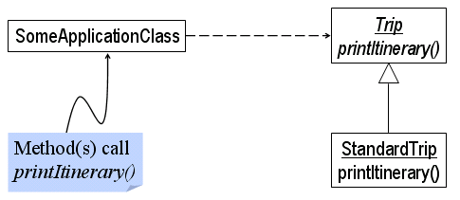
Flexibility: Design for Adding Different Functionality (Cont’d)
Case 1: Handled by adding the new method to an existing set of methods of a class
  Add method print() to the class Itinerary.
Case 2: Adding functionality when a base class exists

Slide 7
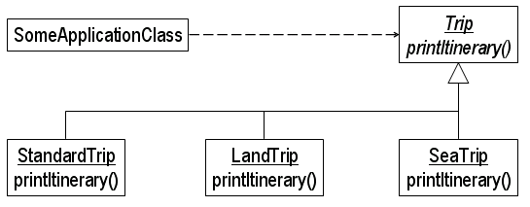
Flexibility: Design for Adding Different Functionality (Cont’d)
Case 2: adding functionality through a base class
Case 3: covered later (chapter 9)

Slide 8
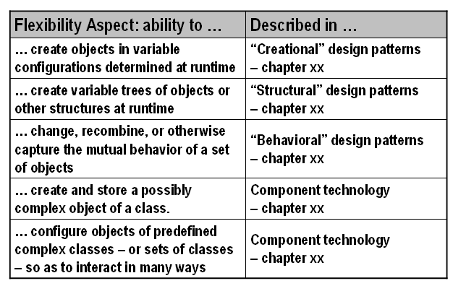
Design for Flexibility
Additional types of flexibility

Slide 9
Reusability
Designing a software system such that components of a developed system can be used again in developing new applications
Reusability is an important factor in producing low cost applications.
Reusability at …
  Architectural/design level
  Implemented component level
This chapter focuses on:
  Reusable functions
  Reusable classes
  Reusable class combinations

Slide 10
Making a Method Reusable
Specify completely
  Preconditions etc.
Avoid unnecessary coupling with the enclosing class
  Make static if feasible
  Include parameterization
    But limit the number of parameters
Make the names expressive
  Understandability promotes re-usability
Explain the algorithm
  Re-users need to know how the algorithm works

Slide 11
Making a Class Reusable
Describe the class completely
Make the class name and functionality match a real world concept
Define a useful abstraction
  Attain broad applicability
Reduce dependencies on other classes
  Elevate dependencies in hierarchy
alternatives

Slide 12
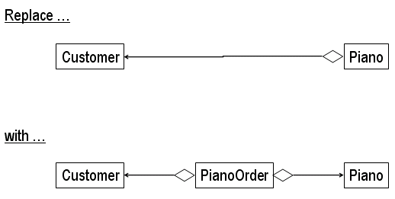
Reducing Dependency Among Classes
Example:
Increase the reusability of a class by reducing its dependencies.

Slide 13
Reusability of Class Combinations
Design patterns are reusable class combinations.
Leveraging inheritance, aggregation and dependency for the reuse of class combinations

Slide 14
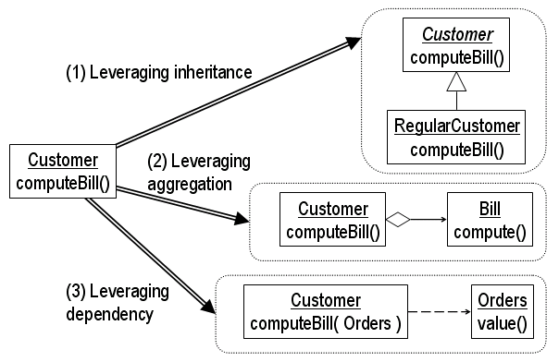
Leveraging Inheritance, Aggregation and Dependency for the Reuse of Class Combinations

Slide 15
Efficiency
Applications must execute required functionality within required time constraints.
Two dimensions of efficiency:
  Time
  Space
Ideally optimize a design for both time and space.

Slide 16
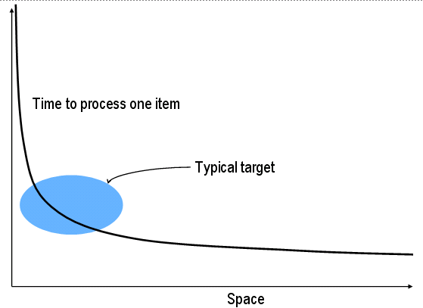
Space-Time Trade-offs

Slide 17
Basic Approaches to Designing Efficiently
Design for other criteria, then consider efficiency
  Design for flexibility, reusability , …
  At some point, identify inefficient places
  Make targeted changes to improve efficiency
Design for efficiency from the start
  Identify key efficiency requirements up front
  Design for these requirements during all phases
Combine these two approaches
  Make trade-offs for efficiency requirements during design
  Address remaining efficiency issues after initial design

Slide 18
Speed Efficiency
Real-time applications are the most demanding in terms of speed.
Profiler--- an application that tracks resource usage during program execution
Impediments to speed efficiency
  Loops
    while, for, do
  Remote operations
    Requiring a network
      LAN
      The Internet
  Function calls
  Object creation

Slide 19
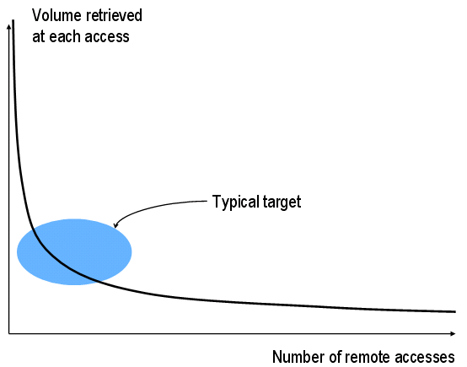
Trade-off Between Number of Remote Calls and Volume Retrieved at Each Call

Slide 20
Storage Efficiency
Attaining Storage Efficiency
  Store only the data needed
    Trades off storage efficiency vs. time to extract and reintegrate
  Compress the data
    Trades off storage efficiency vs. time to compress and decompress
  Store in order of relative frequency
    Trades off storage efficiency vs. time to determine location

Slide 21
Trading off Robustness, Flexibility, Efficiency and Reusability
1A. Extreme Programming Approach
  Design for sufficiency only
1B. Flexibility-driven Approach
    Design for extensive future requirements
    Reuse usually a by-product
2. Ensure robustness
3. Provide enough efficiency
  Compromise re-use etc. as necessary to attain efficiency requirements
* Note that correctness is not included in trade-offs!
or

Slide 22
Pros and Cons of
Extreme vs. Nonextreme Design
Extreme | NonExtreme
+ Job done faster (usually) + More likely to be efficient | + Future applications more likely to use parts + Accommodates changes in requirements
- Future applications less likely to use the work - Refactoring for expanded requirements can be expensive | - Potential to waste effort - Efficiency requires more special attention

Slide 23
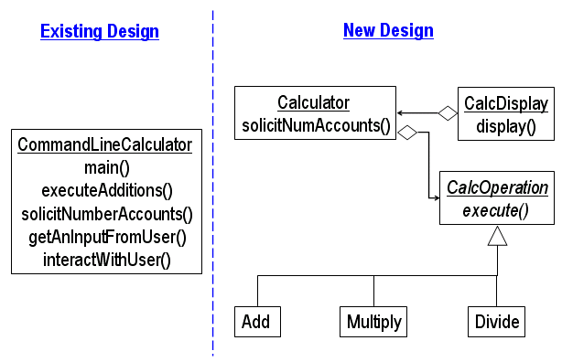
A More Flexible Design for
Calculator Application

Slide 24
Summary
Flexibility
  == readily changeable
Reusability
  in other applications
Efficiency
  in time
  in space
(These add to Correctness & Robustness, covered in chapter 4)

